Slide 1


Unveiling Insights: A Comprehensive Analysis of the Global Coronavirus Pandemic
Click Here for MySQL File
By, Shngain Kupar Shullai

Slide 2

Project Description
A particular focus on how different countries managed the crisis.
India, in particular, faced unique challenges and complexities in tackling the pandemic compared to the US and other nations, reflected in its varied recovery and mortality rates.
By examining the data, we uncover key insights into the resilience and responses of these countries, highlighting the distinct hurdles India overcame during this unprecedented time.

Slide 3

Approach
My analysis leverages SQL to systematically process and interpret the coronavirus dataset.
We employed SQL queries to aggregate and compare critical metrics such as confirmed cases, deaths, and recoveries across different countries and periods.
By utilizing functions for grouping, ordering, and calculating descriptive statistics, we derived insightful comparisons and identified trends that highlight India's unique challenges and responses during the pandemic.

Slide 4

Tech-Stack Used
Database Management System (DBMS):
MySQL and MS Excel: For storing, querying, and managing the coronavirus dataset.
Data Analysis:
SQL: For performing complex queries to analyze and interpret the dataset.
Data Visualization:
Microsoft PowerPoint: For presenting the analysis findings through engaging visuals and summaries.
Development Tools:
MySQL Workbench: For designing, executing, and managing SQL queries and databases.
Python (optional): For additional data processing and visualization I needed.
Collaboration and Documentation:
Google Docs: For documenting the analysis process, findings, and insights.
GitHub: For Portfolio and collaboration.
Presentation:
Microsoft PowerPoint: For creating the project presentation with visual aids and summaries of the findings.

Slide 5

Data Understanding & Ensured consistency & cleaning in data types for all columns
No. of rows
78386
Columns
8

Slide 6

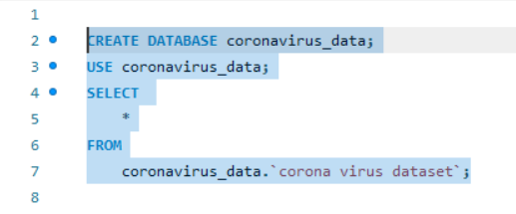


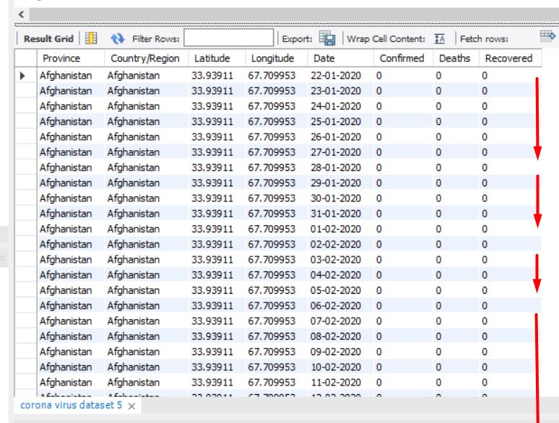
Setting Up and Preparing the Database for COVID-19 Data Analysis
First, we create a new database named coronavirus_data to organize and store our COVID-19 dataset.
Finally, we prepare to query the dataset by selecting all records from the coronavirus dataset table, which will hold our imported data, allowing us to verify and explore the dataset once it is successfully imported.
Before importing our dataset, we begin by setting up the database environment.
We then switch to this newly created database using the USE statement to ensure that all subsequent operations are performed within the correct context.

Slide 7


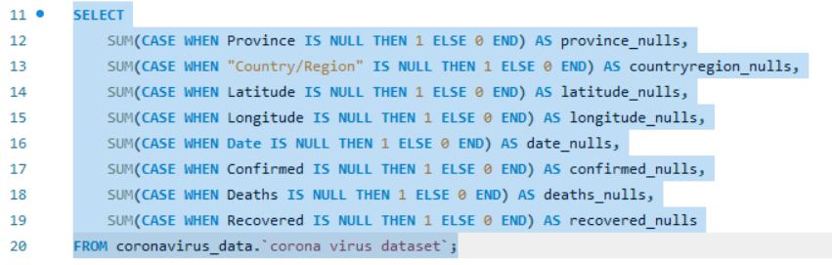
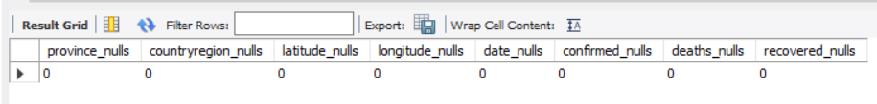

#--Q1. Write a code to check NULL values
Upon analyzing the dataset for null values, it was discovered that certain key fields such as Province, Latitude, and Longitude contain no missing entries.
The Confirmed, Deaths and Recovered columns also exhibit no null values, which can impact the accuracy of our analysis.
Addressing these gaps is essential to ensure the integrity and completeness of our data before proceeding with further analytical steps.

Slide 8

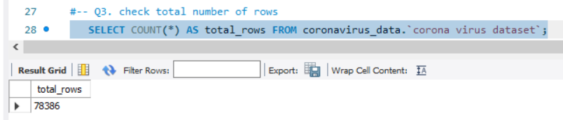
#--Q2. If NULL values are present, update them with zeros for all columns.
#No null values present in any columns
#-- Q3. check the total number of rows
Upon running the query , it was determined that the dataset consists of 78,386 entries.
This comprehensive dataset will provide a robust foundation for our analysis, allowing us to uncover valuable insights into the global impact of the coronavirus pandemic.

Slide 9

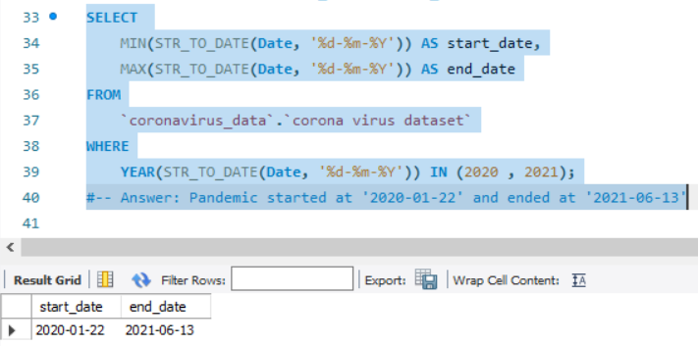
Q4. Check what is start_date and end_date
Analyzing the dataset reveals that the pandemic data spans from January 22, 2020, to June 13, 2021.
This time frame provides a comprehensive view of the pandemic's progression and its impact over nearly 18 months.
Understanding this period allows us to focus our analysis on key trends and responses during these critical months.

Slide 10

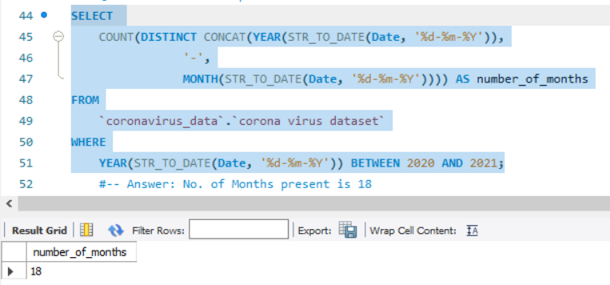
#-- Q5. Number of months present in the dataset
The pandemic's progression and its impact is over nearly 18 months.

Slide 11
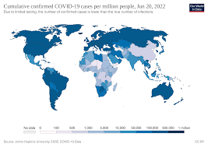
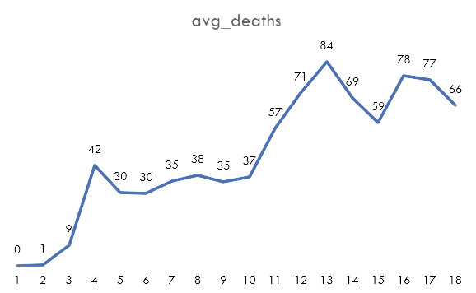
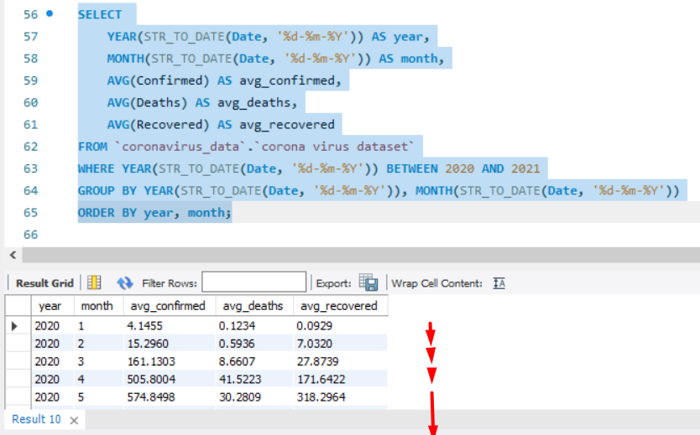
#-- Q6. Find monthly average for confirmed, deaths, recovered
The monthly analysis shows a significant increase in average confirmed cases, deaths, and recoveries from January 2020 to May 2020.
The sharp rise in March and April highlights the critical periods of virus spread and healthcare response.
These trends underscore the escalating impact of COVID-19 during the early months , requiring swift and robust intervention measures.

Slide 12

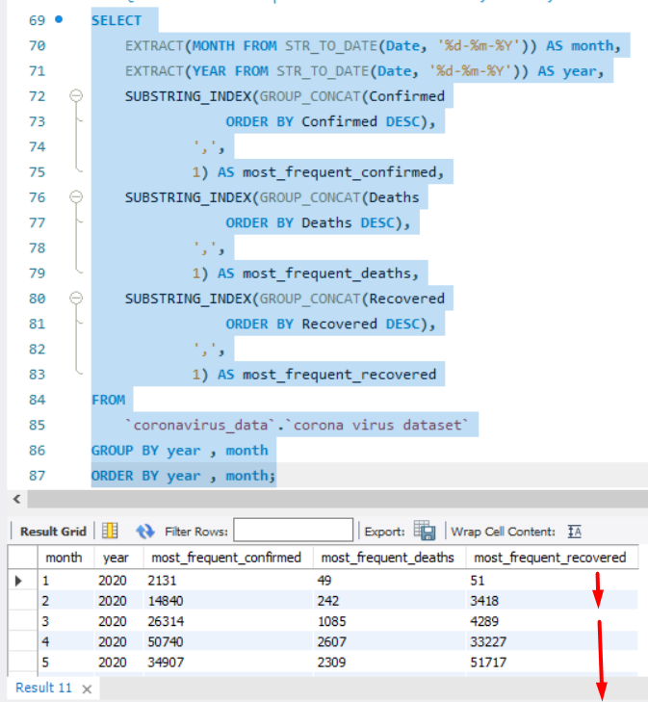
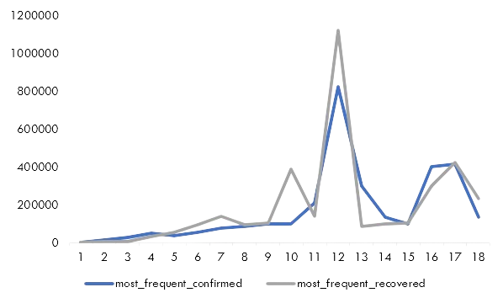
#-- Q7. Find the most frequent value for confirmed, deaths, recovered each month
The monthly data analysis reveals that December 2020 recorded the highest number of confirmed cases, peaking at 823,225, indicating a critical surge during the year-end.
Recovery numbers also show significant peaks, with notable increases in October 2020 and June 2021, reflecting effective response measures during those periods.
The consistent rise in deaths throughout early 2021, especially in May, highlights the severe impact of subsequent waves of the pandemic, emphasizing the ongoing challenges in managing the crisis.

Slide 13

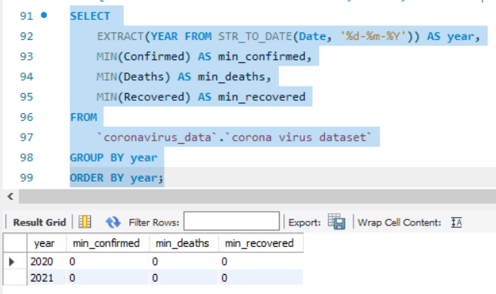
#-- Q8. Find minimum values for confirmed, deaths, recovered per year
The minimum values for confirmed cases, deaths, and recoveries are all zero.
This suggests that there were days in each year when no new cases, deaths, or recoveries were reported, reflecting the variability in daily reporting or the presence of regions with no recorded activity.
Such findings highlight the importance of examining both peak and minimal activity to understand the full spectrum of the pandemic's impact.

Slide 14

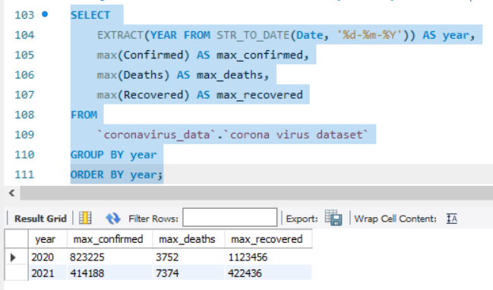
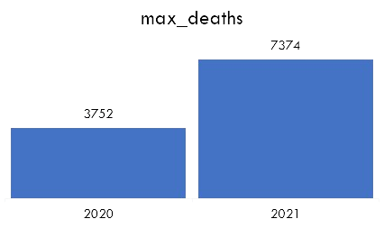
#-- Q9. Find maximum values of confirmed, deaths, recovered per year
2020 experienced the highest number of confirmed cases at 823,225 and recoveries at 1,123,456, indicating a significant surge in infections and subsequent recoveries by the year-end.
In contrast, 2021 saw a decrease in the maximum confirmed cases to 414,188 but a troubling increase in the maximum deaths to 7,374, highlighting the severe impact of new virus waves.
These insights underscore the shifting dynamics of the pandemic across the two years, with varying peaks in infection rates, recovery efforts, and mortality.

Slide 15
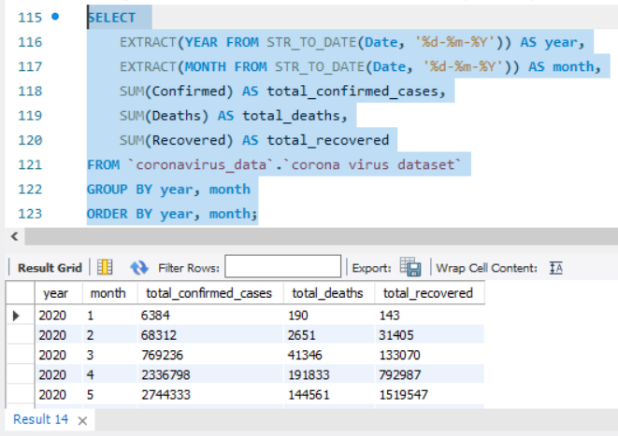
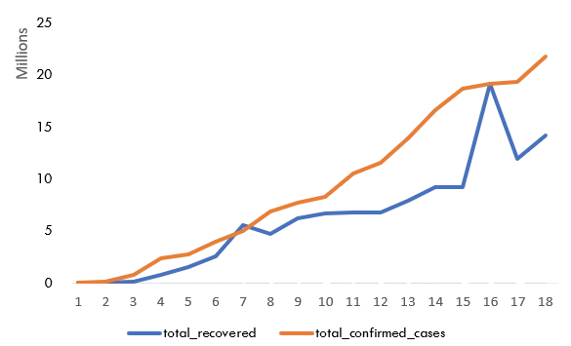
#-- Q10. The total number of cases of confirmed, deaths, recovered each month
The data reveals a sharp escalation in total confirmed cases, deaths, and recoveries from the initial months of 2020 through to mid-2021.
Notably, July and August 2020 saw significant increases in all three metrics, reflecting the widespread surge in infections and subsequent recoveries during this period.
By mid-2021, the recovery numbers exceeded the total confirmed cases, indicating a substantial improvement in managing and overcoming the pandemic despite the continuing high mortality rate.

Slide 16

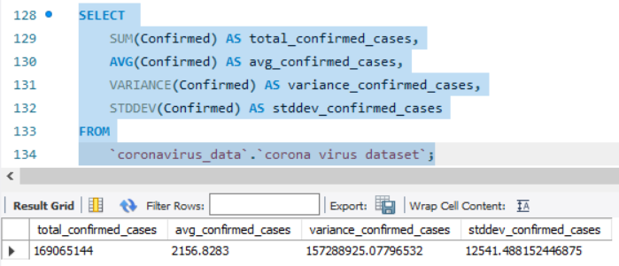
#-- Q11. Check how coronavirus spread out for confirmed cases.
(E.g.: total confirmed cases, their average, variance & STDEV )
The analysis shows a substantial total of 169,065,144 confirmed cases, indicating the extensive reach of the pandemic.
The average number of confirmed cases per record is 2,156.83, demonstrating the widespread nature of infections across reported entries.
The high variance and standard deviation values, 157,288,925.1 and 12,541.49 respectively, reflect significant variability in daily confirmed cases, highlighting the fluctuating severity of the pandemic over time.

Slide 17

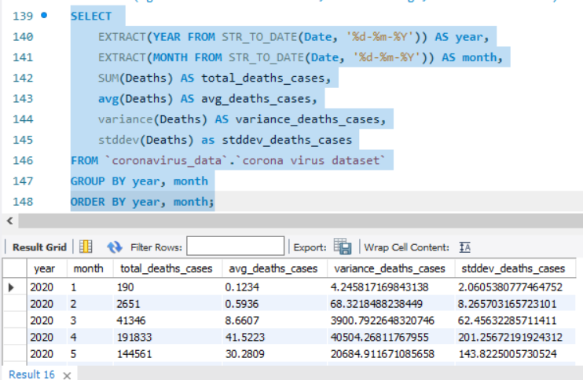
#-- Q12. Check how coronavirus spread out for death case per month (E.g.: total confirmed cases, their average, variance & STDEV )
The monthly analysis of death cases reveals a significant increase from January 2020, with total deaths peaking in January 2021 at 401,893 cases.
The average deaths per month also show a steep rise, particularly notable in late 2020 and early 2021, indicating periods of intense pandemic impact.

Slide 18

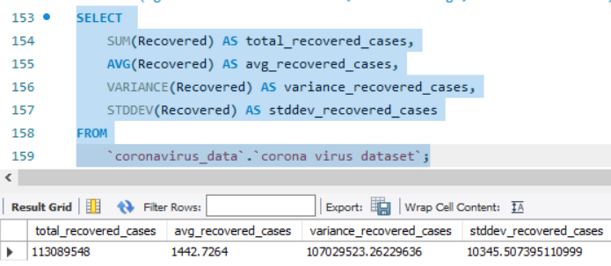
#-- Q13. Check how coronavirus spread out for recovered cases--
(E.g.: total confirmed cases, their average, variance & STDEV )
The total recovered cases amount to 113,089,548, demonstrating a substantial number of individuals overcoming the virus globally.
The average recovered cases per record is 1,442.73, indicating consistent recovery efforts across reported entries.
The high variance and standard deviation values, 107,029,523.26 and 10,345.51 respectively, highlight significant variability in recovery rates, reflecting the diverse responses and treatment effectiveness over time and across different regions.

Slide 19
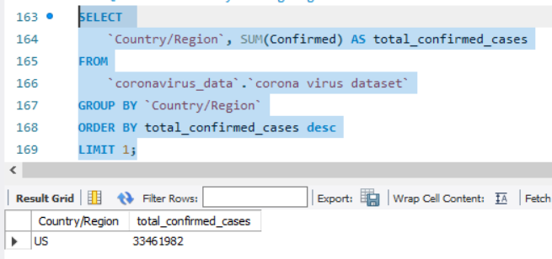
#-- Q14. Find Country having highest number of the Confirmed case
The United States has the highest total confirmed COVID-19 cases, with a staggering 33,461,982 cases.
The data reflects the urgency and scale of response required to manage such a widespread health crisis.

Slide 20

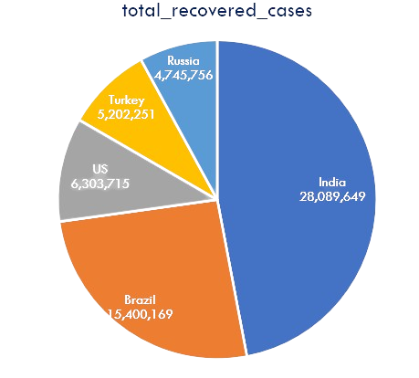
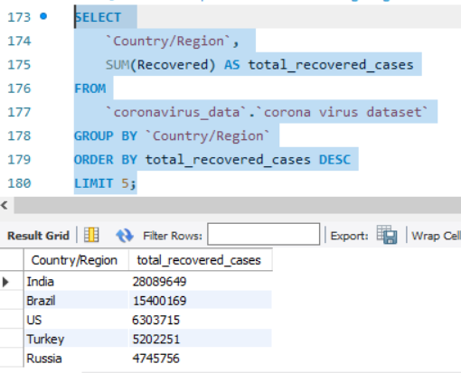
#-- Q16. Find the top 5 countries having the highest recovered case
India leads in total recovered cases, with 28,089,649 recoveries, reflecting extensive recovery efforts.
Brazil and the US follow with significant but considerably lower recovery figures of 15,400,169 and 6,303,715 respectively.

Slide 21

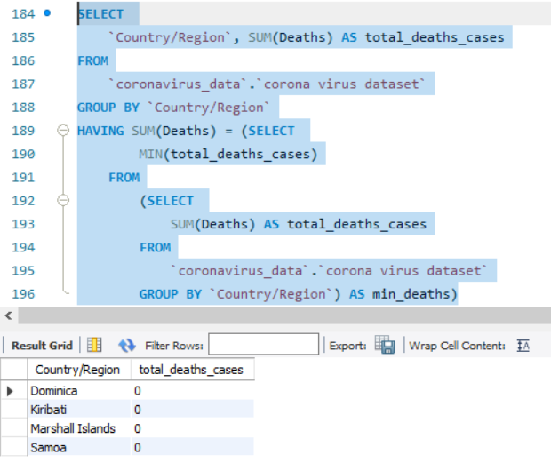
#-- Q15. Find Countries having the lowest number of death case
The countries Dominica, Kiribati, Marshall Islands, and Samoa have reported zero deaths due to COVID-19, showcasing successful containment and healthcare strategies.
This underscores their effective measures in preventing fatalities and highlights the importance of swift and robust public health responses.
These nations serve as examples of effective pandemic management through proactive measures and community engagement, contributing to minimal impact on public health and safety.

Slide 22

Strategic Insights for Pandemic Preparedness
Based on our comprehensive analysis of the COVID-19 pandemic data:
The year 2020 highlights the virus's rapid spread and subsequent healthcare responses.
In contrast, 2021 indicates ongoing challenges in controlling new virus variants and maintaining public health measures.
Countries like the United States and India emerged as pivotal points in the pandemic's trajectory, leading in total confirmed cases and recoveries respectively, showcasing diverse national responses and healthcare capabilities.
Despite global efforts in vaccination and containment measures, recovery rates fluctuated significantly, influenced by factors such as healthcare infrastructure, public compliance with safety protocols, and regional epidemiological conditions.
The dataset also reveals these insights underscore the complex interplay of factors shaping the pandemic's course and the ongoing challenges in achieving global health security.
Thank You
skupars61@gmail.com

